Slide 1
Reproducible Evaluation of Pan-Tilt-Zoom Tracking
Gengjie Chen, Pierre-Luc St-Charles,
Wassim Bouachir, Guillaume-Alexandre Bilodeau
LITIV, Polytechnique Montréal
Robert Bergevin,
LVSN - REPARTI, Université Laval

Slide 2
Background Information
Visual object tracking
Well studied, plenty of datasets/benchmarks (e.g. VOT)
Requires no special link between hardware/software
Only requires “pre-recorded” footage
Simple evaluation (bounding box in image space)
http://votchallenge.net/vot2014/dataset.html

Slide 3
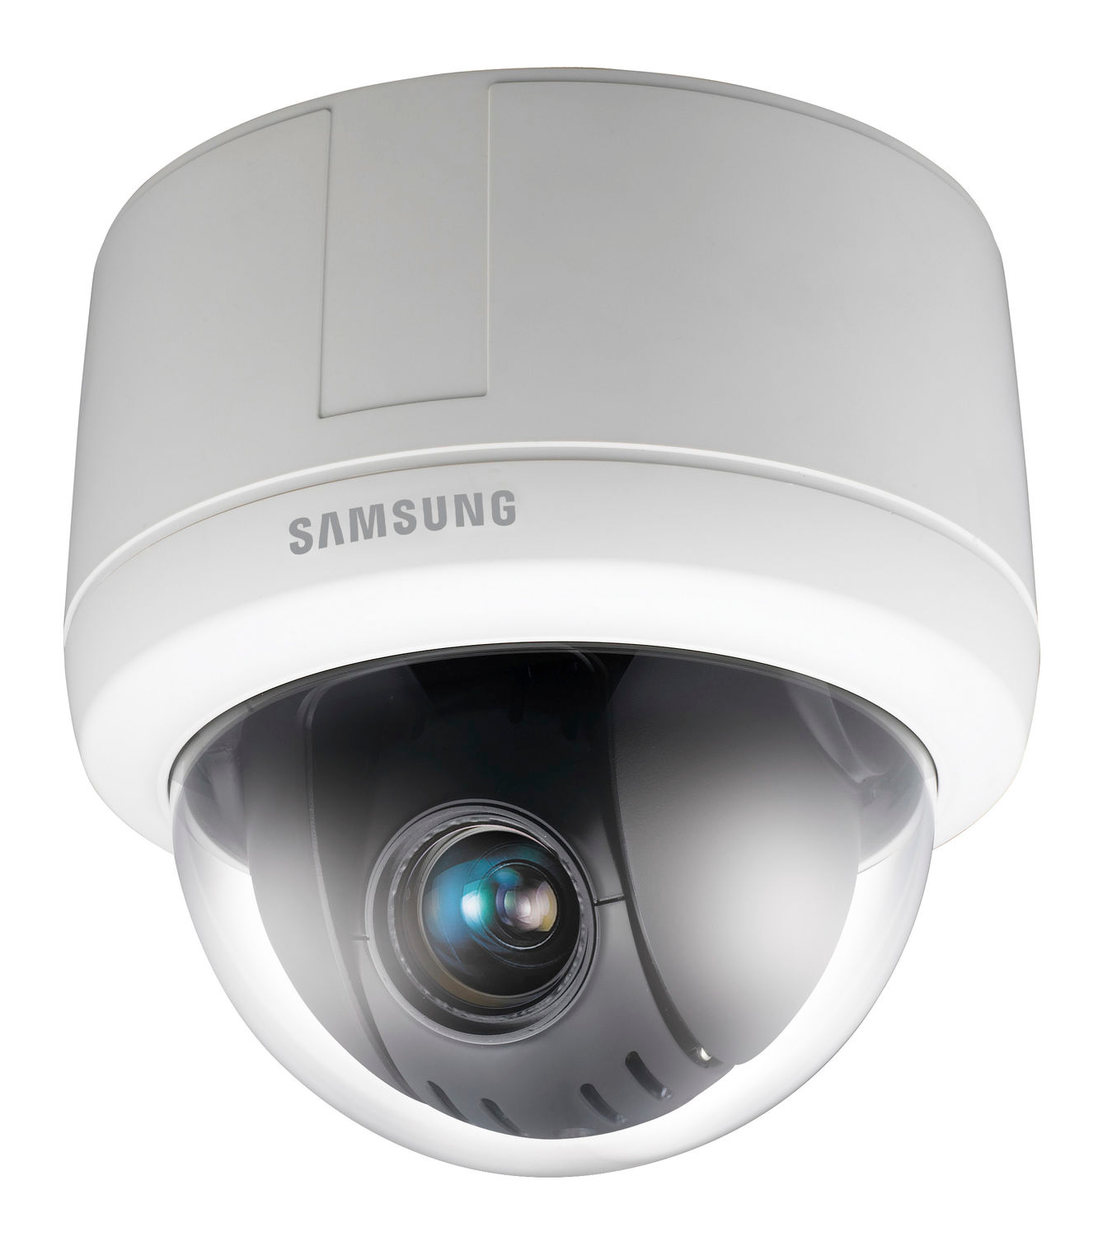
Background Information
Visual object tracking… via Pan-Tilt-Zoom cameras
Algorithm is responsible for camera control (FoV)
Two-way communication between sensor and algo
Online/closed-loop problem with time constraints
Performance depends on response time, hardware
… biggest problem: evaluation.

Slide 4
Problem Statement
PTZ tracking evaluation
Simple fact: camera control = algorithms have unique FoV’s
Inherently, we cannot rely on pre-recorded footage directly
Meaning we never have a “common reference” for comparisons
…otherwise, how can we control all aspects of the test scene?
Therefore, PTZ experiments are not reproducible.

Slide 5
Related Works
Only two papers address this issue to our knowledge:
Qureshi and Terzopoulos (2011)
Fully controlled 3D virtual world with animated pedestrians
Limited realism (lighting conditions, resolution, motion blur, etc.)
Salvagnini et al. (2011)
Real PTZ camera tracks objects on a calibrated projector screen
Only provides reproducible experiments “in-lab” (hardware/calib. dependent)
Limited PTZ operating range

Slide 6
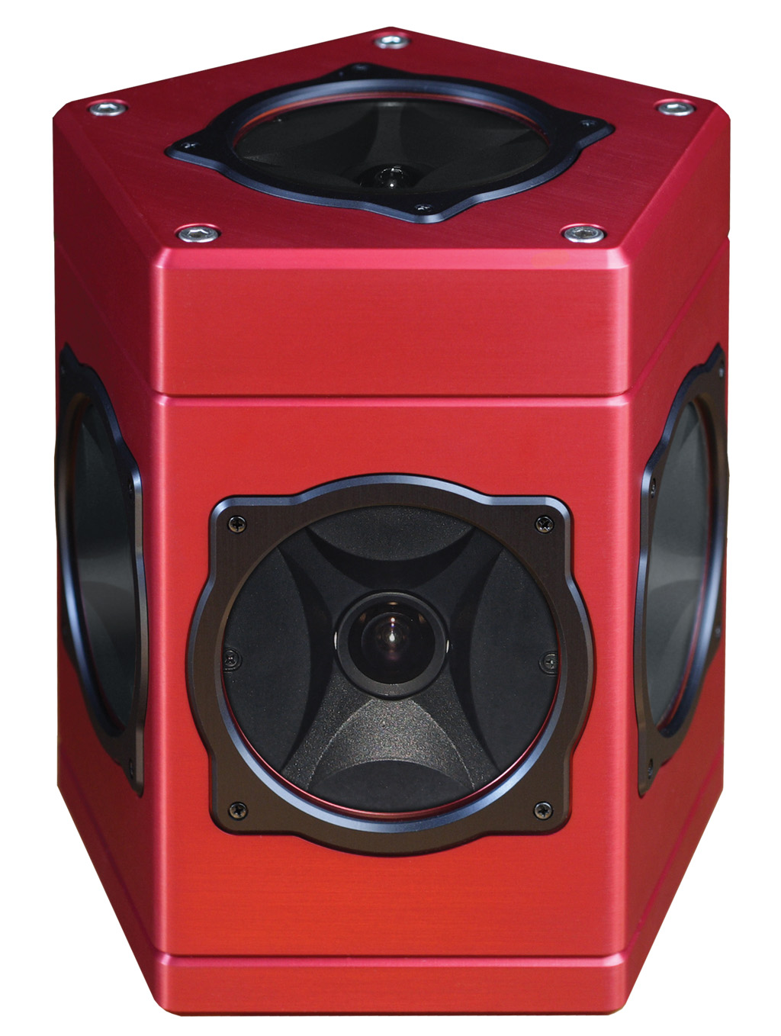
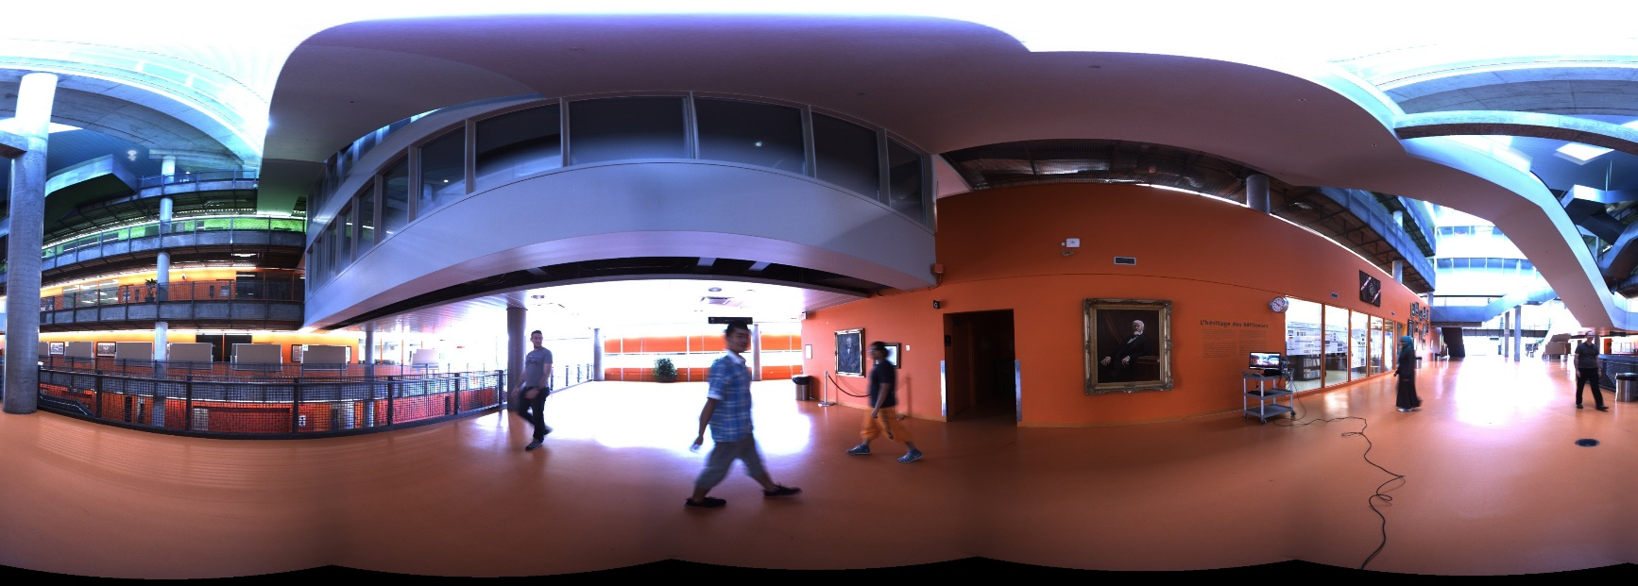
Proposed Framework
Virtual camera in a real video sequence
Pre-capture spherical panoramic videos
Project frames as dynamic texture on virtual sphere
Virtual PTZ camera defined by controllable view frustum
Total abstraction for algo (full pan/tilt/zoom support)
PointGrey Ladybug 3

Slide 7
Proposed Framework
Realistic feedback on control operations
Simulate camera reorientation delays, network delays
Consider time lost by algorithm when processing each frame
Use angular rotation speeds based on real PTZ camera model
Overall, this means:
Time factor is primordial, and has to be considered.
Method has to be approximate/fast, or robust/intelligent.

Slide 8
Proposed Dataset
Tracking sequences
36 sequences taken from three different panoramic video sessions
Each sequence is a few seconds to one or two minutes
Two indoor environments with varied capture conditions
Multiple challenges
Like VOT categories
Motion Blur, Scale Change, Out-of-Plane Rotation, Fast motion, Cluttered Background, Illumination variation, etc.

Slide 9
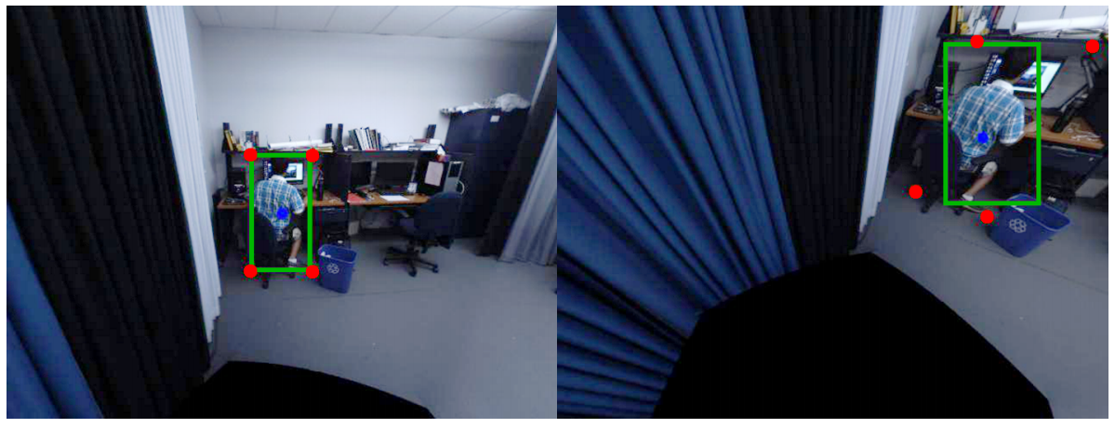
Proposed Dataset
“Reprojectable groundtruth”
Each bounding box encodes camera orientation & width/height
Bounding boxes are unprojected, realigned, reprojected as required

Slide 10
Proposed Dataset
Example of close-up sequences (boxes are groundtruth)

Slide 11
Baseline Experiments
Need evaluation metrics for:
Tracking accuracy
Camera control performance
In the end, we rely on:
Center Location Error (CLE) (tracking accuracy)
Overlap Ratio (OR) (tracking accuracy)
Target to Center Error (TCE) (camera control)
Track Fragmentation (TF) (camera control)

Slide 12
Baseline Experiments
For now, “baseline” set using Camshift (Bradsky, 1998)
Simple strategy, decent results
Fast tracking & decision making, but not very robust

Slide 13
Baseline Experiments
Updated arXiv version with extended results coming soon!
CSK, KCF, SPOT, STRUCK…
CENTER LOCATION ERROR (Pixels)
 | CSK | KCF | STRUCK | CamShift
Full Dataset | 105.3 | 101.0 | 43.5 | 83.2
OVERLAP RATIO
 | CSK | KCF | STRUCK | CamShift
Full Dataset | 0.311 | 0.235 | 0.331 | 0.317

Slide 14
Conclusion
We solve the PTZ tracking reproducibility problem
Our approach relies on real footage, realistic camera model
We consider real time constraints and processing delays
We offer baseline results for you to compare with

Slide 15
Conclusion
Start benchmarking now!
Detailed version:
http://arxiv.org/abs/1505.04502
C++ framework (based on OpenCV/OpenGL) soon available online:
https://www.polymtl.ca/litiv/vid/

